Slide 1
The Anatomy of an Emerging Digital Society A Look into the Future from an Industrial Development Perspective
Qi Lu
Executive Vice President of Microsoft Applications & Services Group
Presented at WSDM on February 22nd, 2016
This document/presentation contains forward looking statements regarding future operations,
product development/capabilities or availability dates, subject to change at any time.

Slide 2
Agenda
Future Through the Lens of Industrial Development
The 3rd Arrival of the Era of IT Industry: An Emerging Digital Society
The Rise of An New Digital Experience Eco-System & Its Structural Anatomy
Opportunities for New Experiences and Platforms
Opportunities for New Foundational Technologies
Opportunities for Re-Writing Rules of Every Segment of the Society
Microsoft’s Ambitions for the Future
Partner Together for a Better Future

Slide 3
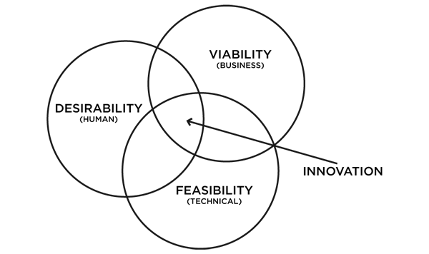
Future Through the Lens of Industrial Development
Navigate the Nexus of Marketplace Innovation
Desirability (Experience)
Feasibility (Technology)
Viability (Business)
Ride the tidal waves and secular trends
Maneuver the movers-and-shakers
Understand the Forces and Players
Product is the core
Technology is the foundation
Business is the make-or-break
Build the Future – the best way to predict it

Slide 4
The 3rd Era of the IT Industry: An Emerging Digital Society
The 1st Era: PC and Client/Server
Digitize what’s on the desk of IW (Information Worker)
PC, Windows OS, File/Folder Metaphor, Mice/Keyboard, GUI, Desktop Apps experience eco-system
Microsoft dominance via the Win-Tel business eco-system
The 2nd Era: Internet and Web
Digitize the world’s public information via a Web of documents
Browser (runtime) + Search (organizing fabric), paginated information + Web App experience eco-system
Google dominance via the search and advertising business eco-system
The 3rd Era: Mobile and Cloud
Digitize every physical structures, physical processes, human activities
The beginning of an emerging digital society

Slide 5
The 3rd Era of the IT Industry: An Emerging Digital Society (Cont.)
Substantially Deeper in Impact & Greater in Scale than Previous Eras
Mobile/Wearable Devices, Embedded Sensors/Controllers at the Edge
Always-on/always-present nature profoundly changes human-computing relationship
Mobile experience becomes a way-of-life, an extension of our presence and capabilities
All human activities will be increasingly digitized
All physical structures and processes will increasingly be “digitally represented/software enabled from within”
Cloud Orchestrated and Delivered Information and Services
Hyper scale storage, compute, and network connectivity covering global endpoints
Vast data streams & computation resulting in digital intelligence, serving as a new form of energy
Fuel innovations that elevate human/commuting experience to new levels
Propel massive transformations by (re)-writing rules of every segment of the society

Slide 6
The Rise of a New Digital Experience Eco-System
The “Why”: the case for a New Experience Eco-System
It needs to scale to the full extent of the mobile & cloud era to unlock all the potential
Mobile Apps will continue to have their roles, but they do not scale well
The Web will continue to have its role, but it is of limited use in current form as it’s not designed for mobile
The “What”: the Rise of Conversational User Interaction (CUI)
The WeChat phenomena in China paved the way
The Slack moment in the US is gaining traction in business enterprises
Facebook and others follow suit to seek a leadership position in the emerging paradigm
Conversation becomes the Gateway to Discover and Access of any Information
Conversation becomes the Launch Pad to Interact with any Applications & Services
The “How”: A Compelling Experience that Truly Scales
Natural Language becomes the general purpose & interactive UI
Digital structure naturally mirrors with the social structures
Works for every user on any endpoints: from children to seniors, from phones to embedded sensors
A society of technologies and truly natural user interactions
Modern machine intelligence and AI enable technology feasibility

Slide 7
The Structural Anatomy of a CUI Experience Eco-System
People graphs
Identity & profile of individual and groups (emergent and structural patterns of people connections)
Conversations
The services and experience endpoint for users to exchange of a sequence of messages with appropriate organizing structures
Human-to-human conversations (augmented with smart messages, e.g., interactive cards with noun + noun + verb, plus dialog flows)
Human-to-bot conversations (each bot can represent set of domain knowledge or Smart-Things, e.g., Slack Bot, Xiaoice, Amazon Echo/Alexa)
Human-to-agent conversations (entrust with data and action-on-behalf, e.g., Siri, Cortana, Google Now, etc.)
Tasks
The experience endpoint for users to conduct activities that fulfill intended purposes for a given domain (e.g. movies, CRM)
The experiences can be GUI based App, Web, as well as conversational dialogs (interactive cards + dialog flow)
Devices
On which the conversations or domain tasks are conducted (PC, phones, wearables, sensors, autonomous vehicles, robots…)
Services
Cloud orchestrated and delivered (e.g., information, media, payment, delivery, transportation/uber ride, etc.)
Organizing Fabrics
The Knowledge Graphs that organize the world’s information and services (build and extend from today’s web)
The corresponding Knowledge Engine that enable new gateways to discover, access, interact all the information and knowledge
Platforms
Players with extensibility mechanism for people, devices, and services to be connected to the knowledge graphs, the conversations, and the tasks

Slide 8
Opportunities for New Experiences and Platforms
People Graphs
Facebook, WeChat, LinkedIn, Microsoft Active Directory, new generation of richer people graphs
Conversations
WhatsApp, Facebook Messenger, WeChat, Skype, Slack, new generation of richer and more intelligent conversation engines
With extensibility and core enabling capabilities, they can become the new onramp and platform for integrating other information and services
Chatbots
Slack Bot, HuBot, Microsoft Xiaoice, Telegram, and many emerging new waves of bots and bot platforms
Intelligent agents / assistants
Siri, Google Now, Cortana, Alexa, Soundhound, Viv Labs, and a growing list of smart assistants
They have a trusting relationship with the user to access data and can act on users’ behalf for tasks
With proper extensibility the agent can become a platform and new generation cross platform runtime
Knowledge Graphs (and Knowledge Engines)
Google, Bing, Baidu, Yandex, opportunity to build new gateway that can discover, access, interact with any info and services
Task-specific/domain specific platforms
Uber, AirBnB, NextDoor, and a new generation future online + offline platforms
Intelligent Devices
Autonomous vehicles, drones, robots (e.g., Amazon Echo), Smart Things, Smart Building, etc.

Slide 9
Opportunities for New Foundational Technologies
Computation Models
For The World (domains and tasks)
For Human Languages
For Users
For Organizations (organized human endeavors)
Machine Intelligence
AI and AGI (capabilities to acquire knowledge, to formulate objectives, to achieve goals….)
Human / Computing Interaction
Virtual Reality, Augmented Reality…
Infrastructure and Tools
Capabilities of building models and engineering intelligent systems
Interconnections between the Physical & Digital Worlds
3D printing, Autonomous Vehicles, Robots, Nano Engineering, Genetic Engineering…
Sensors, Micro-controllers, Nano-controllers, DNA Sequencing, Brain Scanning,…
Quantified Self, Smart Things, Smart Rooms, Smart Cities, …

Slide 10
Opportunities for Re-Writing Rules for Every Segment of Society
Physical Systems (e.g. Product) can increasingly be Digitally Enabled
Embedded sensors and controllers that are connected to the cloud
Software and data models can infuse intelligence to elevate performance
Ever expanding scope and scale via advances of frontiers such as nanotechnologies
Physical Processes can increasingly be Digitally Represented and Enhanced
Mobile/wearable devices, embedded sensors/controllers, all connected via the cloud
Digital models of manual, mechanical, electrical, chemical, biological processes
Every Segment of Society will increasingly be elevated by Re-Writing the Rules
Profound change of industrial and social landscape
Massive value creation opportunities
A Growing List of Examples
Digital health / wellness, digital finance, e-sports, logistics, manufacturing ….
Uber (Sharing Economy)…

Slide 11
Example: The WeChat Eco-System

Slide 12
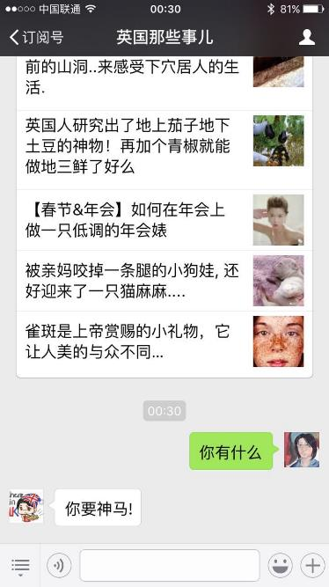
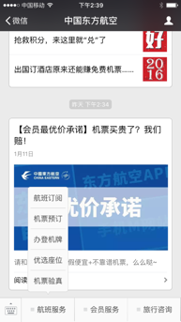
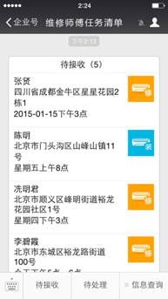
Conversational UI in WeChat Public Accounts Users talk to these accounts via IM, to retrieve content, send feedbacks and complete tasks
Content account
Service account
Corporate account
Living in UK
China Eastern Airline
Contact list for technicians
WeChat public accounts have different purposes
Switch to
Conversation UI

Slide 13
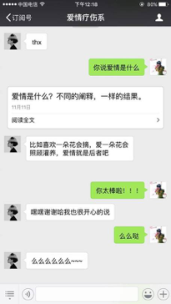
Chatbots (e.g. Xiaoice) Become an Interface for Public Accounts
With scanning a QR-code, a 3rd party WeChat public account can let Xiaoice be its CUI
Xiaoice indexes content from the public account with Bing search technology
Xiaoice handles the human to agent conversation, and in parallel triggers account specific cards
Over 1M cards have been indexed. Average CTR is close to 40%
How you define Love?
Xiaoice triggered a Card
Jump to a content of this official account, which was automatically indexed by Xiaoice - <What is love? Too many meanings but the same result>
In parallel, Xiaoice replied with her general conversational service
If you like a flower, you will take it. If you love it, you will raise it. This is what we call love.
You are so amazing!!!
Haha thank you I am very happy as well
Muah
Muah muah muah ~~~

Slide 14
Example: Slack & the Slack-Bot Eco-System

Slide 15

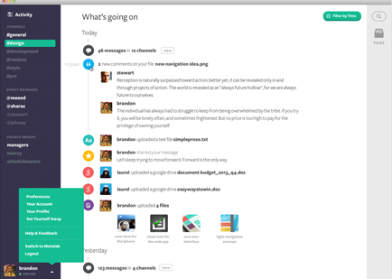
Slack – Team Communication
Channels for team conversations: per project, topic, team, general,…
Private channels
Direct messages
Share docs/content in channel
Connect tools and get their notifications: support requests, sale leads, code check-ins, …
Structured Search on messages, shared content and notifications
Communicate with Slack bots as if they are co-workers

Slide 16
Slack Bots: Rapidly Increasing Capabilities
Slack bots automate repetitive tasks: scheduling meetings, sending meeting alerts, ordering lunch, translating text, managing your receipts, managing your to do lists
Slack teams can install bots from Slack directory
Users use bots through natural language conversation, without leaving the conversation channel, instead of using external apps
Bots can also contact the user directly with questions, based on triggers: e.g.,
Ask the user if he wants to order lunch (on a daily basis)
Ask meeting participants to send agenda (15 minutes before the meeting should start)
A manager can send a daily scrum report questions to his team members. The bot will ask the team members, collect their answers and send the manager a merged report

Slide 17
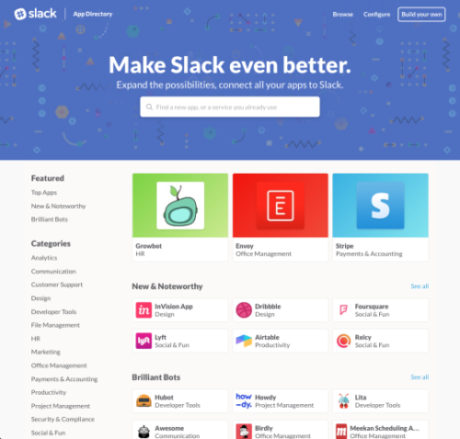
Slack Directory of Bot Platform
https://slack.com/apps
Sample categories: design, marketing, office management, developer tools, productivity
Launched on Dec/15
Well over 150 apps, growing rapidly
$80M fund to help developers to build slack apps
Howdy.ai Botkit: building blocks for building Slack bots

Slide 18
Example: The Sharing Economy Revolution
There are many names from Collaborative Economy, Peer Economy, On-Demand Economy (ODE), Collaborative Consumption, Online Economy, Gig Economy, Mesh, Crowd Economy, Concierge Economy, 1099 Economy, WTF? (What’s The Future) Economy, Next Economy, ..etc.

Slide 19



Reshape the Labor Market and Nature of Work
App-driven labor and asset sharing markets (Uber, Airbnb, Upwork, etc.) are at the center of redefining work, and how people think about their jobs​
LABOR
(e.g., driver’s time)
ASSETS
(e.g., car, apartment)
Slice up a broad array of traditional jobs into discrete tasks (microtasks) that can be assigned JIT (Just-In-Time) to people​ or AI
Wages/Prices set by a dynamic measurement of supply and demand​
SOFTWARE PLATFORM
Increased efficiency in allocation
(algorithmic matching, pricing)
Worker’s performance constantly tracked, reviewed and subject to customer satisfaction​
Valuable data as by-product: intent, process, transaction, reputation tracking
SERVICE
(e.g., Uber, Airbnb, UpWork)

Slide 20
Microsoft’s Ambitions for the Future
Empower People & Organizations on the Planet to Achieve More
Change the World Again by
Re-inventing Productivity
Creating More Personal Computing
Building the Intelligent Cloud
Commitment to Deep R&D to Advance Foundational Technologies
Investment in AI and other fundamental technologies
E.g., HoloLens and Xiaoice as a breakthrough AI product
Strive to Transform and Deliver Leading Experiences across Work/Life/School
Office 365
Skype / Bing / Cortana

Slide 21
Example: Xiaoice

Slide 22
Xiaoice (Little Bing): Connect Human to World with Conversations
A chat-bot based on Bing search technology
High user engagement (CPS=23) with strong emotional connections
A personal companion to a user; also a public celebrity on social media (weibo)
Xiaoice / Rinna
General Conversational Service
Human
World
with Text, Voice, Image
and Video senses
Knowledge, Information
and Service
Key Living Spaces
40M+ Login User
User base
+
Social roles
800M+ Reach Audience
JD
Weibo
WeChat
LINE
…
Dragon TV
Media official accounts@WeChat

Slide 23
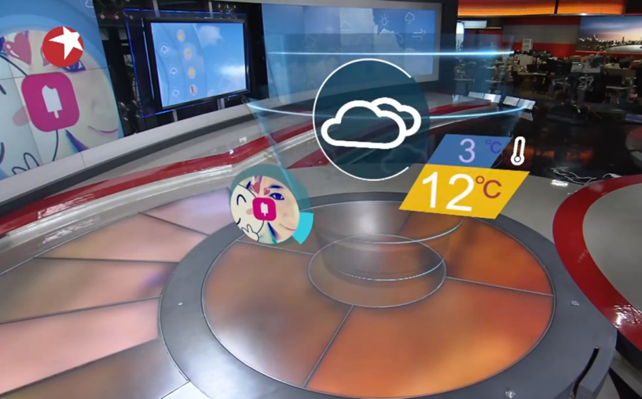
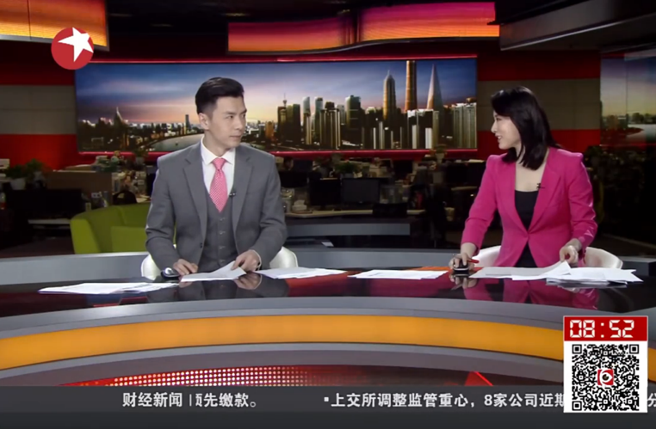
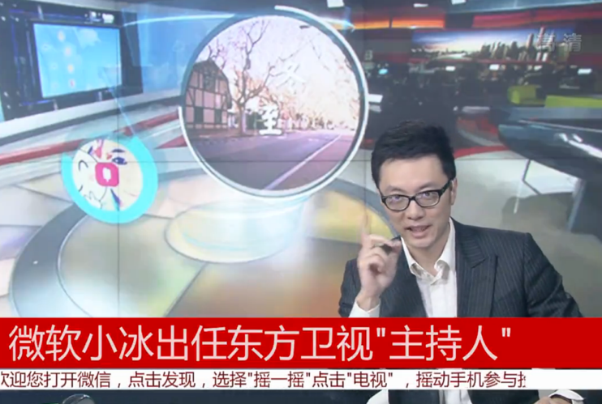
Xiaoice is on Dragon TV
Xiaoice has become trainee anchor for live TV programs on Dragon TV
Dragon TV is one of China’s largest TV stations, has a viewer population >800M
First AI robot to have real broadcasting job on a TV station
First weather broadcasting and commenting every morning 7:00AM – 9:00AM. Will expand her job scope to comment on news, host real-time audience votes and audience connections

Slide 24
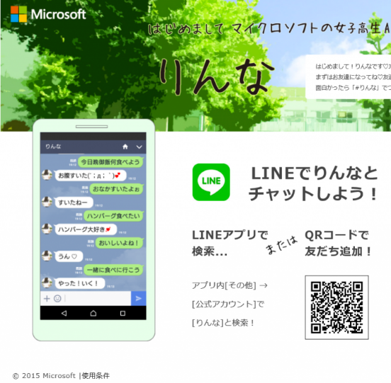

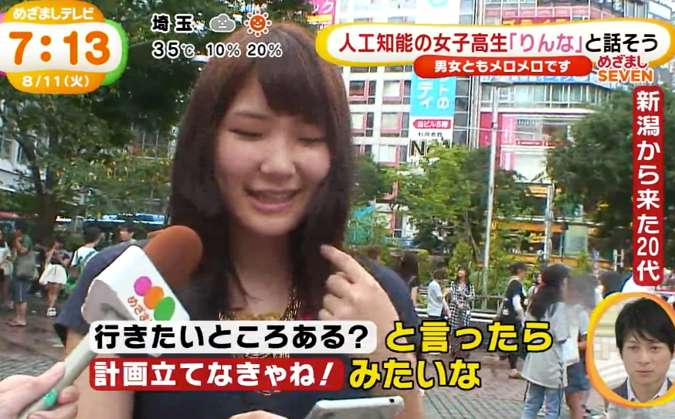
Rinna is Xiaoice in Japan
Xiaoice with Japanese culture and language, developed by Bing team onsite in Japan
Living in LINE and Twitter. Connected with over 1% Japan population within just 20 days
Growing rapidly, already one of the most famous AI characters in Japan

Slide 25
Example: Office 365

Slide 26
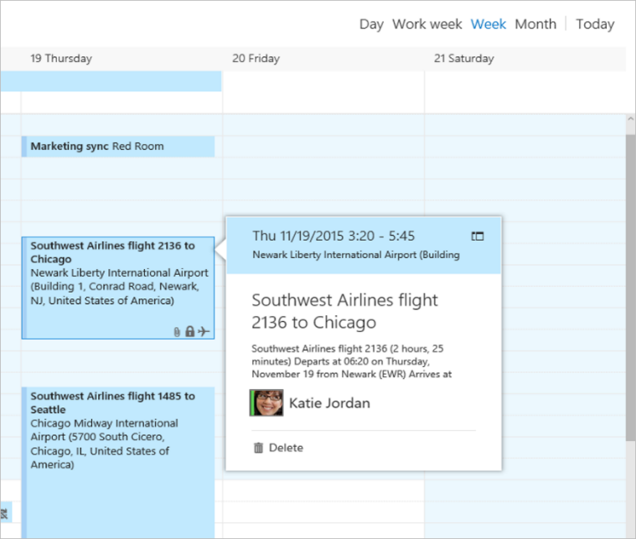
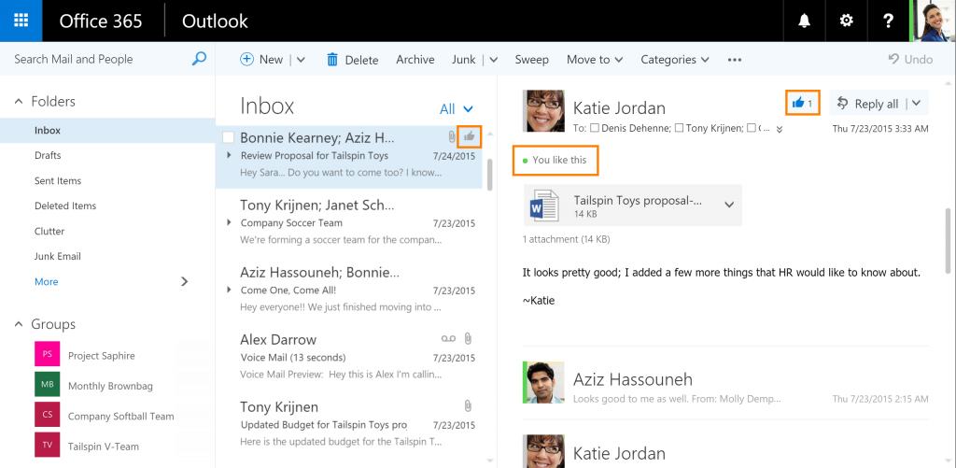
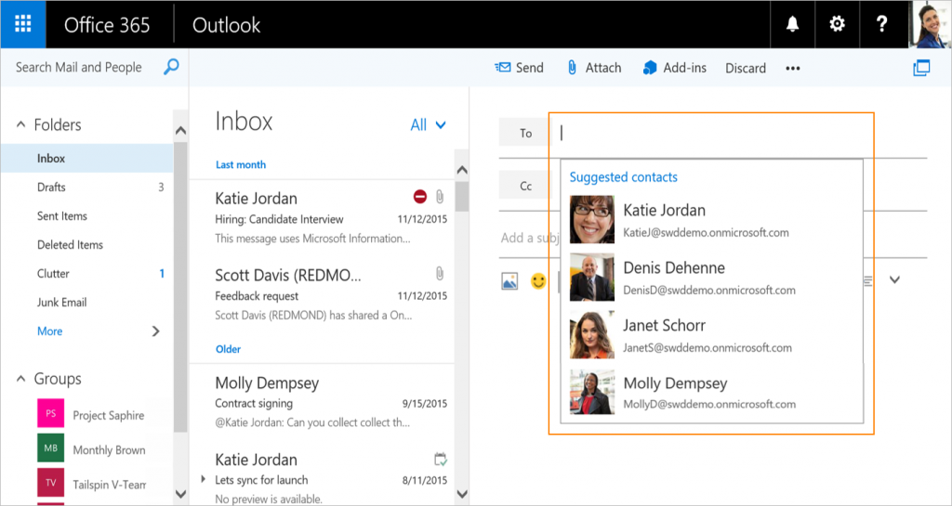
Office 365
Flight confirmations in your calendar
Pushing the frontier of productivity via Data and Intelligence
Search & Discovery
Insights & Actions
Collaboration (#hashtag, @mention, …)
Fundamentally change the way of reading and writing
Create a path towards the future of workplace, the future of work
Surface the best ideas
Smarter Address Book

Slide 27
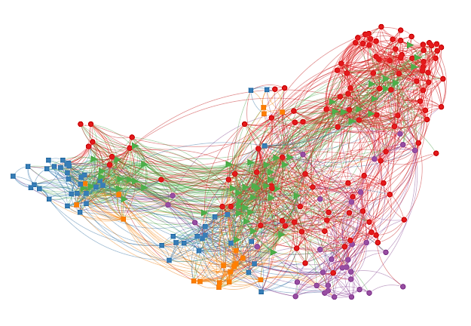
Organizational Analytics
Always-on measurement of the workplace social graph
Time and relationships: the building blocks of work
Advance prediction of critical business outcomes
Sales
Network size
Time with manager
Network efficiency
Channel partner
Sales quotas
Attrition
Engagement
Satisfaction
Revenue
Time with customers
Customer sentiment
Customer network velocity
Customer contacts
Focus time
Meeting quality
After-hours collaboration
Services and support
Marketing

Slide 28
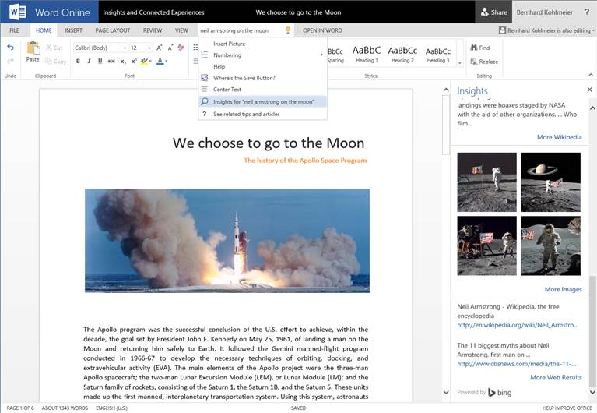
More and more Insights and Intelligent Services for Documents

Slide 29

Advanced eDiscovery Analytics
Applies machine learning to enable users to explore large, unstructured data, sets to quickly find what is relevant
Clustering Technology
Themes to identify data relationships
Near Duplicates
Reduce the data which is sent to review
Email Threading
Reconstruct email threads from unstructured data
Predictive Coding
Trains the system to identify relevant documents

Slide 30
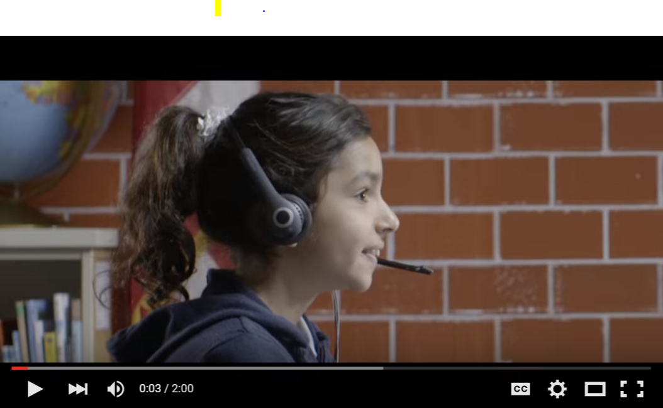
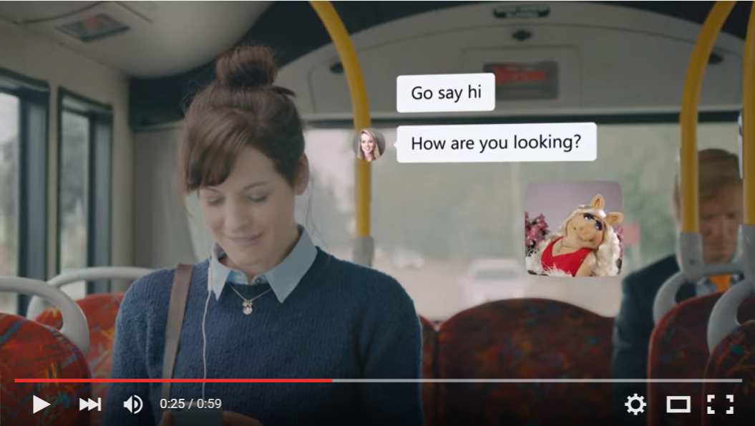
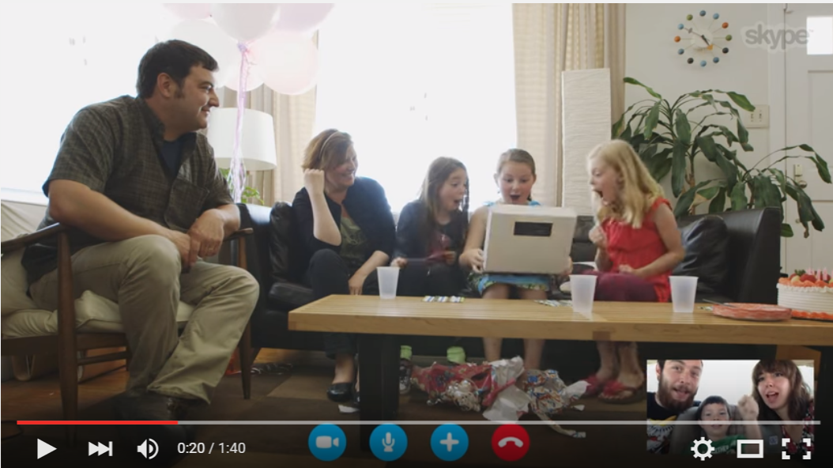
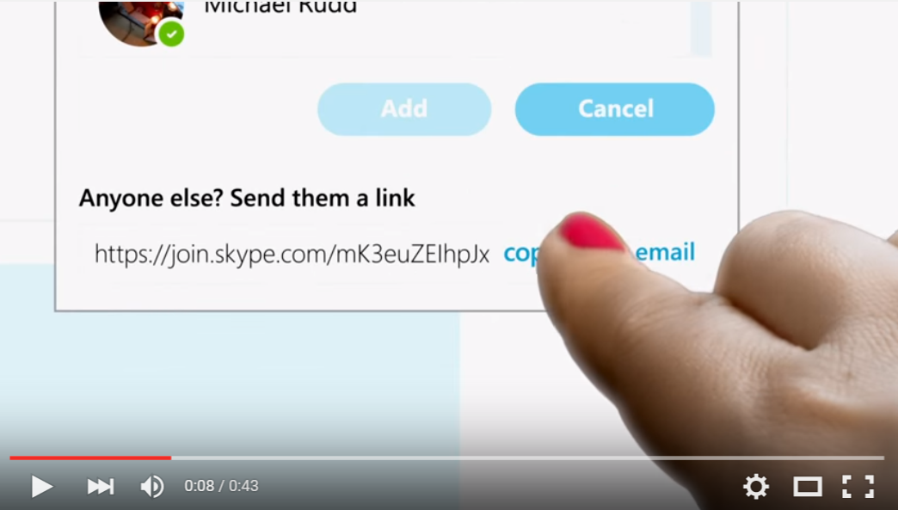
Skype/Skype for Business
Innovation
Skype Translator
Skype Mojis
Group Engagement
10 Years of Video Calling
URL invites

Slide 31
Partnership Together for a Better Future
Our Heritage of Building Enabling Horizontal Platforms
Our Investment in Research
Our Pursuit of Big Dreams
We Welcome Opportunities to Collaborate Broadly
Let’s Build a Better World Together

Slide 32
Thank You!

Slide 33
Q&A

